Slide 1


Team 12 202012004 - Niharika Srivastava 202012018 - Aryan Gambhir 202012019 - Dharmik Dave 202012071 - Jitusingh Rajpurohit 202012088 - Bhavika Tahiliani 202012122 - Bushra Sama
CANVAS API

Slide 2
What is CANVAS API?
The Canvas API provides a means for drawing graphics via JavaScript and the HTML <canvas> element.
The Canvas API largely focuses on 2D graphics. The WebGL API, which also uses the <canvas> element, draws hardware-accelerated 2D and 3D graphics.
The <canvas> element has only two attributes, width and height.
The <canvas> element can be styled just like any normal image (margin, border, background…)

Slide 3
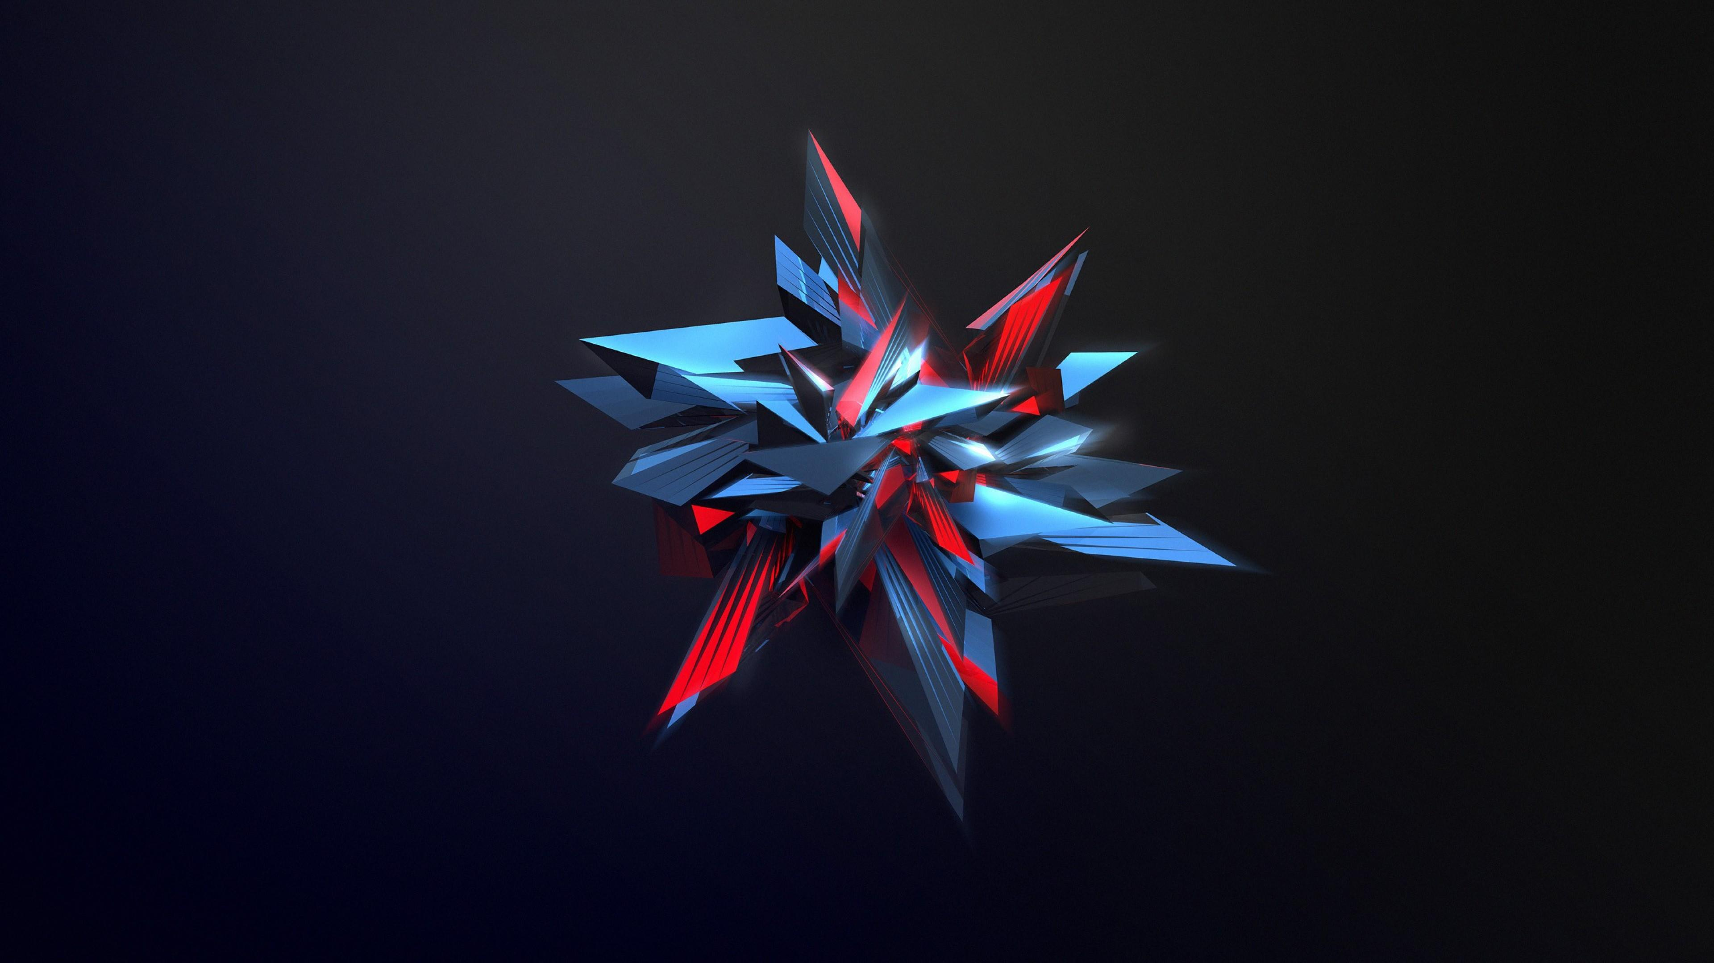
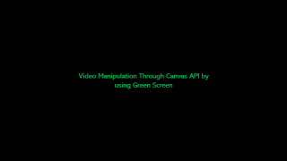
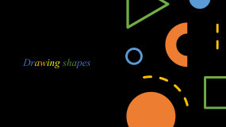
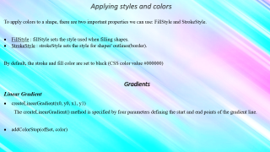
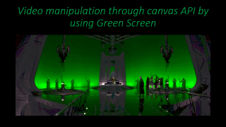
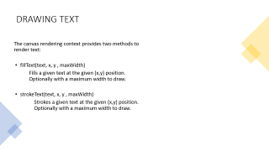

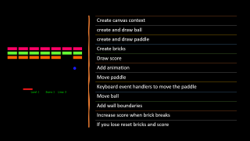

Slide 4
Drawing shapes

Slide 5

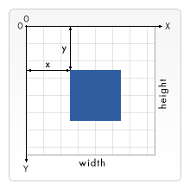
Grids
Before we can start drawing, we need to talk about the canvas grid or coordinate space.
<canvas> only supports two primitive shapes: rectangles and paths (lists of points connected by lines).

Slide 6
Drawing Rectangle
First let's look at the rectangle. There are three functions that draw rectangles on the canvas:
1.)fillRect (x, y, width, height)
Draws a filled rectangle.
2.)strokeRect (x, y, width, height)
Draws a rectangular outline.
3.)clearRect (x, y, width, height)
Clears the specified rectangular area, making it fully transparent

Slide 7
Drawing Path
A path is a list of points, connected by segments of lines that can be
of different shapes, curved or not, of different width and of different color.
create the path.
Draw the path.
Render the path.
Here are the functions used to perform these steps:
beginPath():-
Creates a new path.
closePath():-
Adds a straight line to the path, going to
the start of the current sub-path.
stroke():-
Draws the shape by stroking its outline.
fill():-
Draws a solid shape by filling the path's content area.

Slide 8
DRAWING TEXT
The canvas rendering context provides two methods to render text:
fillText(text, x, y , maxWidth)
Fills a given text at the given (x,y) position. Optionally with a maximum width to draw.
strokeText(text, x, y , maxWidth)
Strokes a given text at the given (x,y) position. Optionally with a maximum width to draw.

Slide 9
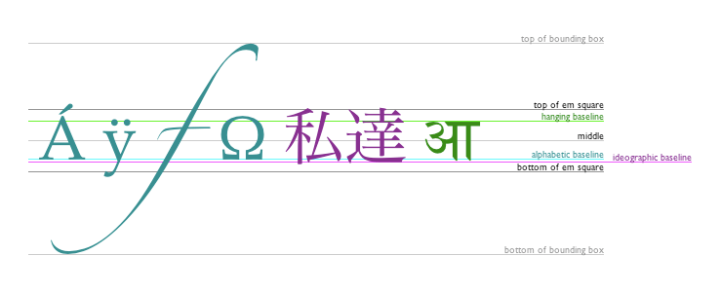
Styling Text
There are some properties which will let us adjust the way the text gets displayed on the canvas:
font = value
Fills a given text at the given (x,y) position.
textAlign = value
Fills a given text at the given (x,y) position.
textBaseline = value
Fills a given text at the given (x,y) position.
direction = value
Fills a given text at the given (x,y) position.

Slide 10

Drawing Image
Once we have a reference to our source image object we can use the drawImage() method to render it to the canvas. As we will see later the drawImage() method is overloaded and has several variants. In its most basic form it looks like this:
drawImage(image, x, y)
Draws the CanvasImageSource specified by the image parameter at the coordinates (x, y).
Scaling
The second variant of the drawImage() method adds two new parameters and lets us place scaled images on the canvas.
drawImage(image, x, y, width, height)
This adds the width and height parameters, which indicate the size to which to scale the image when drawing it onto the canvas

Slide 11
Slicing
The third and last variant of the drawImage() method has eight parameters in addition to the image source. It lets us cut out a section of the source image, then scale and draw it on our canvas.
drawImage(image, sx, sy, sWidth, sHeight, dx, dy, dWidth, dHeight)
Given an image, this function takes the area of the source image specified by the rectangle whose top-left corner is (sx, sy) and whose width and height are sWidth and sHeight and draws it into the canvas, placing it on the canvas at (dx, dy) and scaling it to the size specified by dWidth and dHeight.

Slide 12

Applying styles and colors
To apply colors to a shape, there are two important properties we can use: FillStyle and StrokeStyle.
FillStyle : fillStyle sets the style used when filling shapes.
StrokeStyle : strokeStyle sets the style for shapes' outlines(border).
By default, the stroke and fill color are set to black (CSS color value #000000)
Gradients
Linear Gradient
createLinearGradient(x0, y0, x1, y1)
The createLinearGradient() method is specified by four parameters defining the start and end points of the gradient line.
addColorStop(offset, color)

Slide 13
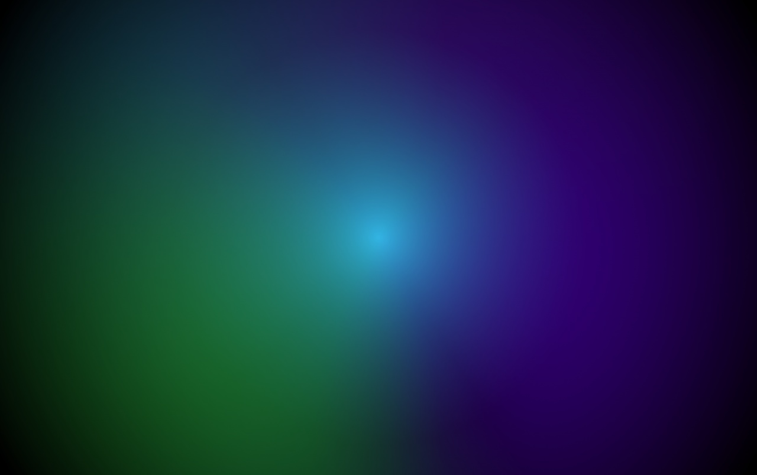
Radial Gradient
createRadialGradient(x0, y0, r0, x1, y1, r1)
The createRadialGradient() method creates a radial/circular gradient object.
Parameters:-
x0 : The x-coordinate of the starting circle of the gradient
y0 : The y-coordinate of the starting circle of the gradient
r0 : The radius of the starting circle
x1 : The x-coordinate of the ending circle of the gradient
y1 : The y-coordinate of the ending circle of the gradient
r1 : The radius of the ending circle
addColorStop(offset, color)
Parameters:-
Offset : A number between 0 and 1, inclusive, representing the position of the color stop.
Color : A CSS<color> value representing the color of the stop.

Slide 14
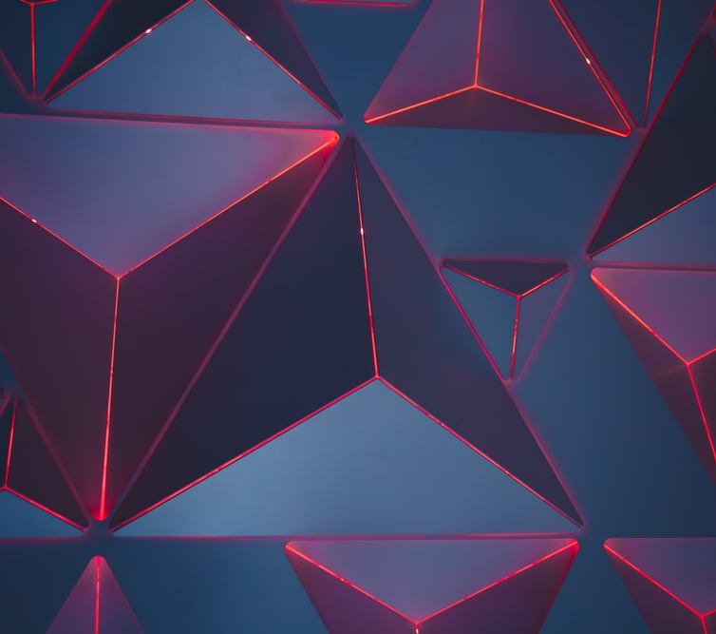
Patterns
createPattern(image, type)
The createPattern() method repeats the specified element in the specified direction.
Parameters:-
image : The element can be an image, video, or another <canvas> element.
type : The type specifies how to use the image in order to create the pattern, and must be one of the following string values:
repeat : Tiles the image in both vertical and horizontal directions.
repeat-x : Tiles the image horizontally but not vertically.
repeat-y : Tiles the image vertically but not horizontally.
no-repeat :Doesn't tile the image. It's used only once.

Slide 15
STEPS FOR ANIMATION
Clear the canvas
Save the canvas state
Draw animated shapes
Restore the canvas state

Slide 16
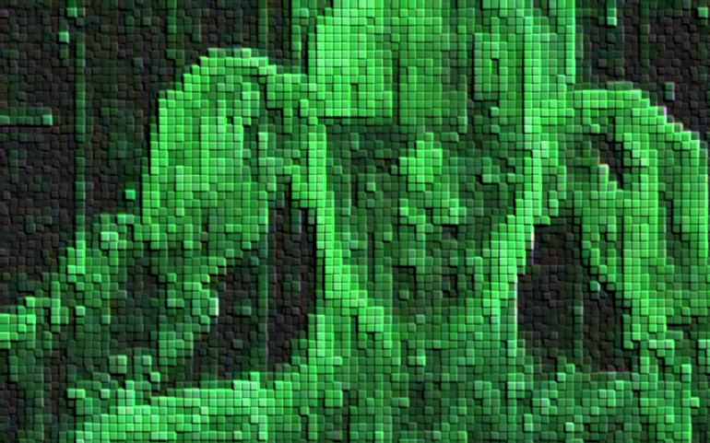
The user can manipulate pixels (the basic unit of programmable colour on a computer display or in a computer image). The user can erase, create, copy, and move pixels on a screen to show something different than it was originally
Methods for pixel manipulation -
1. drawImage(image , x, y)
The drawImage() method draws an image, canvas, or video onto the canvas. We are using the drawImage() method to draw image on the canvas.
2. getImageData(x, y, width, height)
The getImageData() method returns an ImageData object that copies the pixel data for the specified rectangle on a canvas.
3. putImageData(ImageData, x, y)
The putImageData() method paints data from the given ImageData object onto the canvas.
4. createImageData()
The createImageData() method creates a new ImageData object. All pixels present in ImageData are transparent black (rgba(0,0,0,0))
Pixel Manipulation

Slide 17
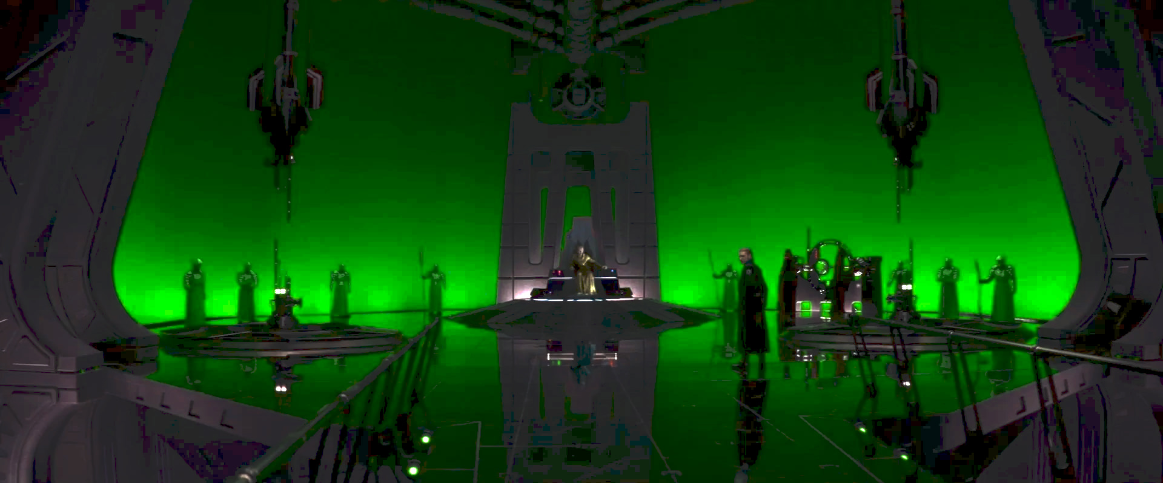
Video manipulation through canvas API by using Green Screen

Slide 18
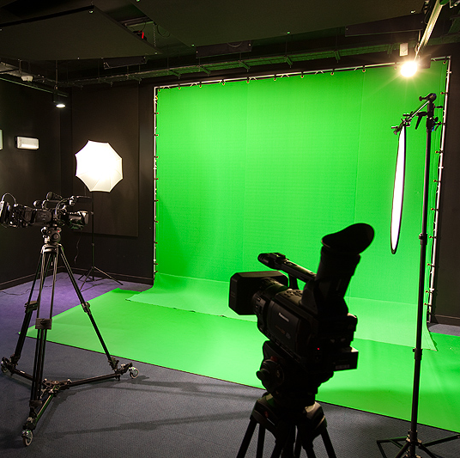
What is a Green Screen?
The Green Screen refers to the Green colored background which we intend to make transparent and remove from our shot while creating virtual effects and virtual backgrounds for movies, news and weather reports ...etc.
What is Chroma Keying?
Chroma Keying is the popular technique through which transparency is achieved in the process of creating visual effects.
The term Chroma stands for colour and the term Keying refers to the process of removing the green colour of the screen in post-production using a video editing software.
When the green screen background has been keyed (removed), it becomes fully transparent. We can then fill the transparent area with a different image or video.

Slide 19
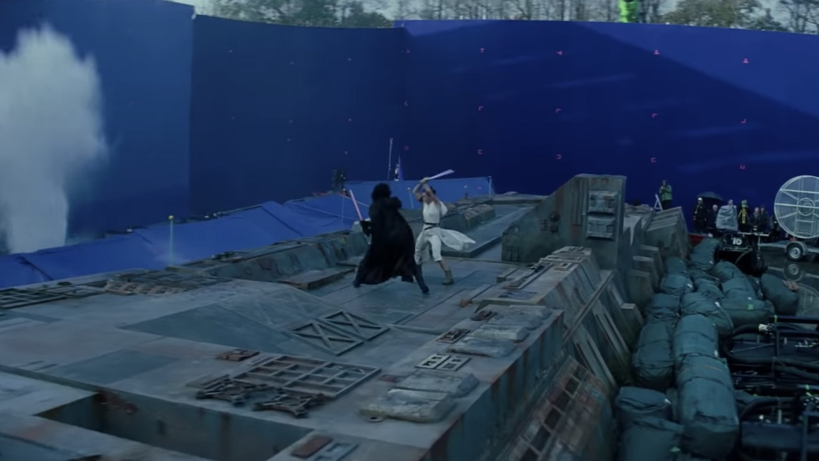
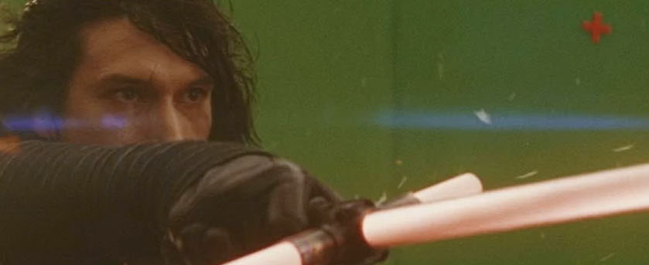
Some FACTS about green Screen
The color of the screen is usually selected as ‘Bright Green’ because it is the color furthest away from human skin tones.
Blue screens were frequently used in the early days in film production and are still used in certain cases.
Myth - It is a common myth that only Green colour can be used for making of the screen. Any colour which is the opposite of the colour of the desired object which needs to be shot, can be used as the colour of the screen. Black, Grey, and even White seamless backdrops are popular green screen alternatives for digital still photography.
In the movie Spiderman the villain green goblin was green in colour, and thus, blue screens were used while taking his shots. Spiderman’s costume was red and blue in colour, so green screen was used in his shots. But when Spiderman and Green Goblin had scenes together, a different colour screen had to be used.

Slide 20
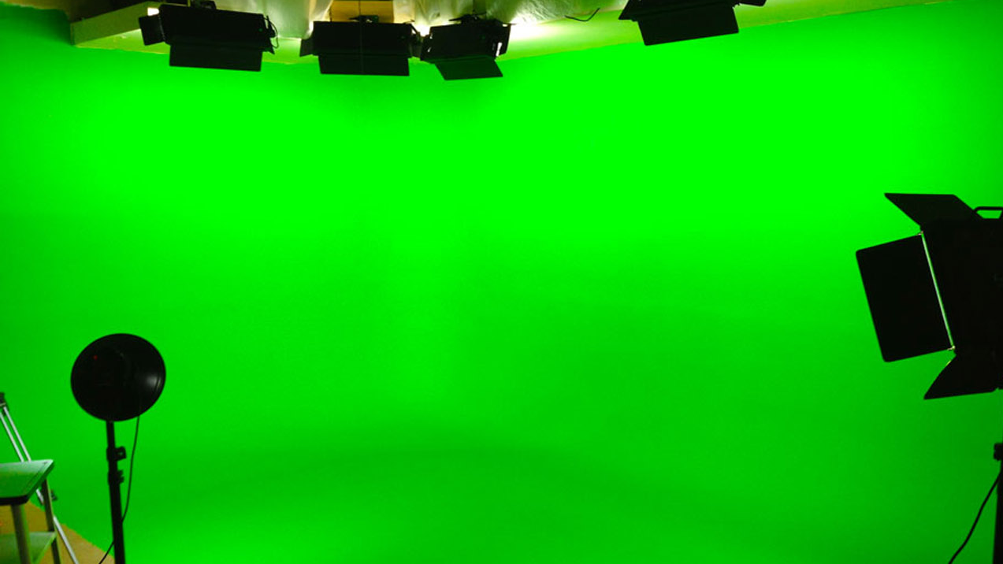
Methods used for achieving chroma keying
Note: The ImageData object is not a picture, it specifies a part (rectangle) on the canvas, and holds information of every pixel inside that rectangle.
video_object.addEventListener(‘play’, myScript) :-
HTML Audio/Video DOM play event - The play event occurs when the audio/video object has been started or is no longer paused.
context.drawImage(video , x, y, width, height) :-
The drawImage() method draws an image, canvas, or video onto the canvas. In this demo, we will be using the drawImage() method for positioning the video on the canvas and specifying the width and height of the video.
context.getImageData(x, y, width, height) :-
The getImageData() method returns an ImageData object that copies the pixel data for the specified rectangle on a canvas.

Slide 21
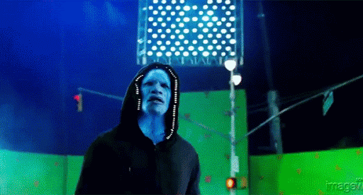
context.putImageData(ImageData, x, y)
The putImageData() method puts the image data (from a specified ImageData object) back onto the canvas.
requestAnimationFrame(callback)
The requestAnimationFrame() method tells the browser that we wish to perform an animation and request the browser to call a specified function to update an animation before the next repaint.

Slide 22
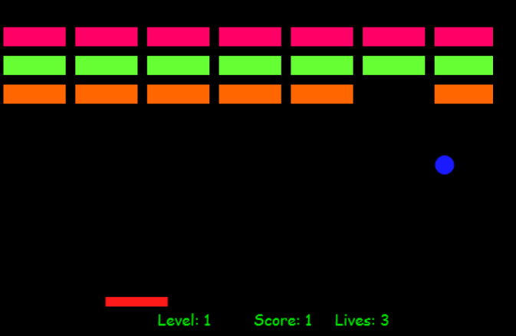
Create canvas context
create and draw ball
create and draw paddle
Create bricks
Draw score
Add animation
Move paddle
Keyboard event handlers to move the paddle
Move ball
Add wall boundaries
Increase score when brick breaks
If you lose reset bricks and score

Slide 23
1)Create canvas context
2)Create and draw ballx: canvas.width :- position of ball on x axis.
y: canvas.height :- position of ball on y axis.
3)Create and draw paddlex: canvas.width :- position of ball on x axis
y: canvas.height :- position of ball on y axis.
size:- size of ball.
speed:-speed of ball.
dx:- speed and direction on x axis.
dy:- speed and direction on yaxis.
ctx.beginPath(); :- to define the path of ball on x and y axis.
ctx.arc(x-axis,y-axis,radius,start angle,end angle)
ctx.fillStyle='color' :- to fill color nad make visible.
ctx.closePath():- to close path
w:-width
h:-height *speed:-speed of ball.
dx:- speed and direction on x axis.
ctx.beginPath(); :- to define the path of ball on x and y axis.
ctx.rect(x-axis,y-axis,width,height)
ctx.fillStyle='color' :- to fill color nad make visible.
ctx.closePath():- to close path
document.getElementById();
canvas.getContext('2d'); :- to create shapes.

Slide 24
4)create bricks
w:-width of brick
h:- height of brick
padding:- spacing between bricks
offsetX:- position of brick on x-axis
offsetY:- position of brick on y-axis
visible:- to make brick visible
transparent:-to make brick invisible
ctx.rect(x-axis,y-axis,width,height)
5)draw score
ctx.font="font family“
ctx.fillTxt:-to display score
6)add animation
window.requestAnimationFrame(function name):- to add animation on ball and paddle,from here everything is controlled by javascript logics.
7)move paddle
To move the paddle we append the paddle.x value(position of paddle on x-axis) to paddle.dx value(add speed and direction to paddle)
paddle.x += paddle.dx
For paddle to detect wall
paddle.x + paddle.w > canvas.width

Slide 25
8)keyboard event handlers to move paddle
document.addEventListener(key, function name):- add event listener to give conrol to keyboard keys.
9)move ball
To move the ball, we append the ball.x value(position of ball on x-axis) to ball.dx value(add speed and direction to ball)
10)add wall boundaries
window.requestAnimationFrame(function name):- to add animation on ball and paddle,from here everything is controlled by javascript logics.
11)increase score when bricks break
To move the paddle we append the paddle.x value(position of paddle on x-axis) to paddle.dx value(add speed and direction to paddle)
paddle.x += paddle.dx
For paddle to detect wall
paddle.x + paddle.w > canvas.width
ball.x += ball.dx

Slide 26
References
https://developer.mozilla.org/en-US/docs/Web/API/Canvas_API
https://www.w3schools.com/html/html5_canvas.asp
https://medium.com/jspoint/a-basic-introduction-to-canvas-api-to-draw-2d-3d-graphics-on-web-15d251a675a3
https://youtu.be/NousxgBDIr4
https://youtu.be/0GBJr9ohai0
https://mixkit.co/free-stock-video
https://pixabay.com/videos/

Slide 27
Conclusion
Through this presentation we tried to cover basic properties and advanced implementations of the canvas API, to get comprehensive understanding through insightful demos.

